Slide 1
Hack & Slash Template
Project 3 unreal Template - Arnaud benier moine – 6th April 2022

Slide 2

Project 3 – Constraints
Engine : Unreal Engine 5
Objective : Create tools for Game Designers
Assets : Modular 3D models

Slide 3
First thoughts
Create a Basic Hack & Slash Template with a Top-Down Camera
Player has multiple ability
Multiple Enemies with different behavior

Slide 4
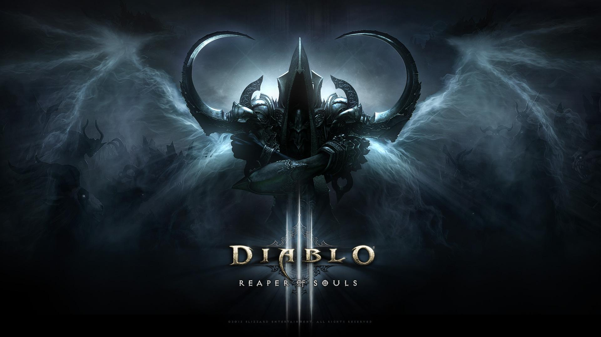
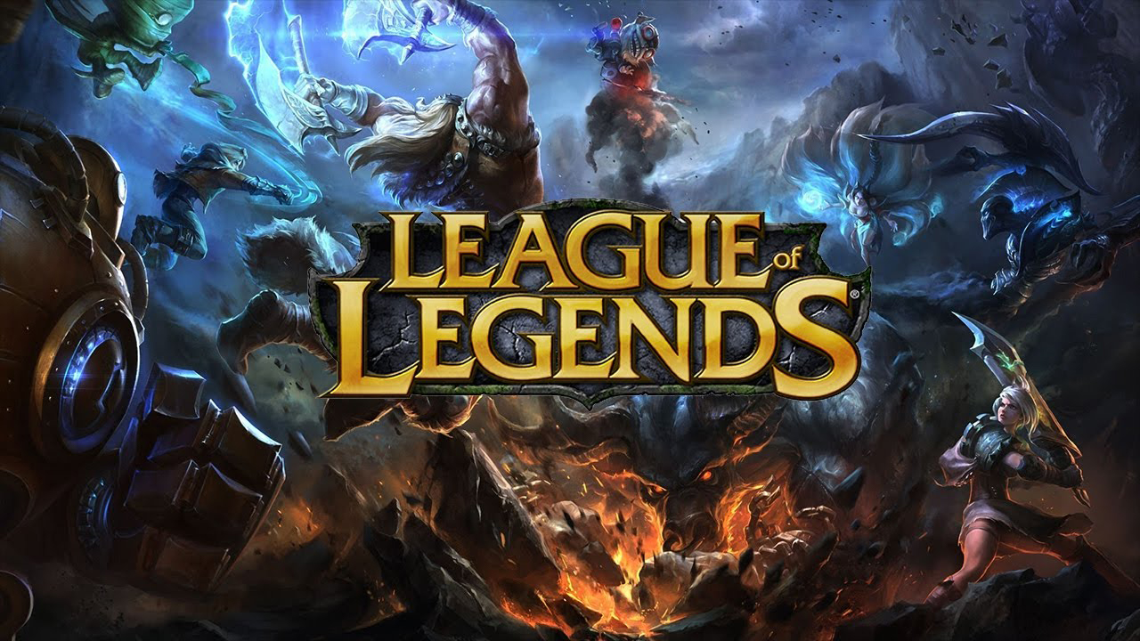

References
Diablo III – Blizzard Entertainement
Hack & Slash Aspects
League of Legends – Riot Games
Gameplay
FromSoftware’s games
Player & Enemy Behavior
Notes:
Diablo : Hack & slash Reference / Camera / Level
League : Mouse Movement / Keyboard Ability
FromSoftware : Player & Enemy behavior design

